Slide 1
“Wisdom of crowds” approach to influenza forecasting
Jeff Morgan
19morgan@cua.edu
http://www.influenzamodelselection.com/
CUA BE 499
February 25, 2019

Slide 2
Agenda
Problem I Want to Solve: Multiple infection prediction models are created when there are disease outbreaks, but decision-makers want to view a single forecast that is accurate.
Background
Research Areas and Research Opportunities
Influenza and Influenza Like Illness
Predict the Influenza Season Challenge
Approach
Results from 2017-2018
Websites
Incentives for participation
Acknowledgements
Questions

Slide 3
Background
I would like BE 499 students to vote on which model they believe is most accurate for specific targets and geographic areas
BSME University of Maryland, College Park
Part-time MS Applied Math and MS Engineering and Physics of Biomedicine, Johns Hopkins University
Part-time PhD Student in Biomedical Engineering at Catholic University (19morgan@cua.edu)
Completed Coursework and Comprehensive Exam
Dissertation remains – still fleshing it out
Engineer for Joint Research and Development, Inc. (www.jrad.us)
Currently working on experiment to track exposures throughout military career
Support the Pandemic Prediction and Forecasting Science and Technology Working Group (PPFST WG)

Slide 4
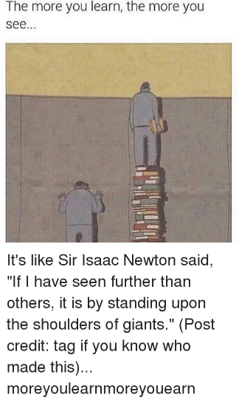
Research Areas
Important time to be an engineer or scientist
Capabilities
Internet / online courses / youtube / social media
Big Data and Computer processing speed
Open Data; free software
Important Global Issues
Environment/Global Climate Change
Sustainable Energy
Food Supply
Plastic
Multi-drug resistance
Cybersecurity
Artificial Intelligence
We know a lot of things that don’t cure cancer so we can try something else

Slide 5
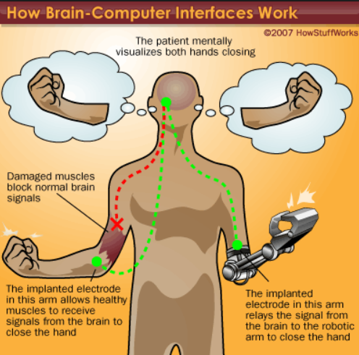
Research Areas - BME
People who have suffered disease and injury know challenges can be overcome
Brain-computer interface
Prosthetic devices
Artificial organs
Tissue Engineering
Surgical robots
Medical Imaging
Telemedicine

Slide 6
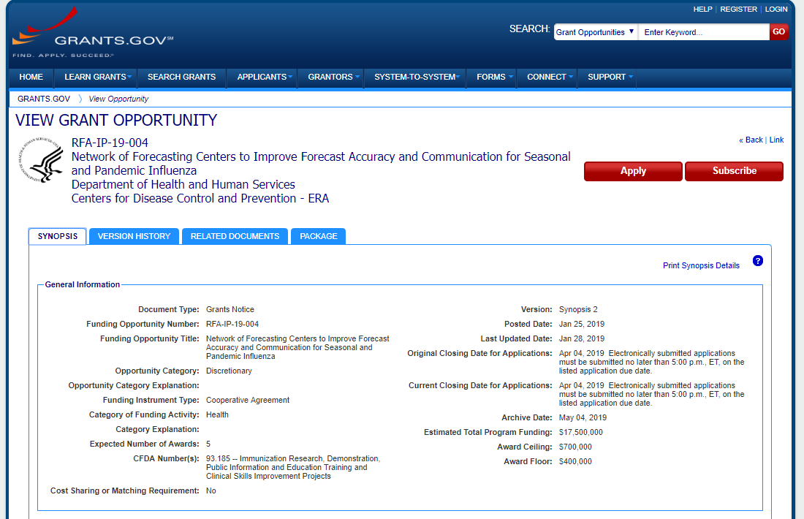
Research Opportunities
Two types of engineers
Those that write proposals and those that don’t
Grants
National Institute of Health (NIH)
National Institute of Biomedical Imaging and Bioengineering (NIBIB)
DoD Small Business Innovation Research (SBIR) and Small Business Technology Transfer (STTR)
National Science Foundation
Many others
Social Media

Slide 7
Wisdom of Crowds
Incorporates the insight, knowledge, and nuggets of information held by many people into collective wisdom
1906 – Francis Galton went to a fair and observed contest to guess weight of an ox after it had been “slaughtered and dressed” (Surowiecki)
787 guesses were averaged and the average guess was 1,197 pounds
Actual weight was 1,198 pounds
Many applications
Which Ebola model to believe
Which Climate Change model to believe
Which weather forecast to believe
Four conditions that characterize wise crowds (Surowiecki)
Diversity of Opinion (Crowd members don’t have to be experts)
Independence
Decentralizaion
Aggregatiion

Slide 8
Influenza and Influenza Like Illness (ILI)
Influenza
Varies in intensity;
CDC estimates for 2017-2018 Season in U.S. (Source: https://www.cdc.gov/flu/about/burden/2017-2018.htm)
48,800,000 illnesses (> combined population of Texas and Florida) (7,000,000 prevented by vaccine)
959,000 hospitallizaions (> number of staffed hospital beds in U.S.) (109,000 prevented by vaccine)
79,400 deaths (> average number of Super Bowl attendees) (8,000 prevented by vaccine
ILI Case definition: Fever >100°F AND (Cough AND/OR Sore Throat) in the absence of a known cause other than influenza (Source: https://www.tdcj.texas.gov/divisions/cmhc/docs/cmhc_infection_control_policy_manual/B-14.51.pdf)
ILI%: Participating health centers report the percentage of patients with ILI symptoms
wILI%: Weighted ILI% such that higher population areas are given more weight
Delay between when patient arrives at hospital and CDC releases data

Slide 9
Influenza and Influenza Like Illness (ILI)

Slide 10
Influenza and Influenza Like Illness (ILI)

Slide 11
Influenza and Influenza Like Illness (ILI)
Tools to combat Influenza
Vaccines
Public Service Announcements (vaccines, hand-washing, cough etiquette)
Social Distancing (e.g., close schools, church)
Environmental Surface Cleaning and Disinfecting
Unvaccinated healthcare providers may be re-assigned to duties without patient contact
Quarantine
Isolate patients with ILI
Antiviral therapy (e.g., Tamiflu™)
Antiviral Chemoprophylaxis
Problem: Optimize Mitigation Activities to Lessen the Burden of Seasonal Influenza

Slide 12
Predict the Influenza Season Challenge
Began with the 2013-2014 flu season to encourage the scientific community to make advances in the field of flu forecasting
“Average” of the models outperformed most of the models
Intuitively, even better results would be attained by assigning more weight to the better models
Other disease forecasting challenges have shown “Ensemble Models” outperform a single model
Another group is investigating various algorithms to assign higher weights to better performing models
CDC grant lists 5 specific aims including “Refine methods to create forecast ensembles”

Slide 13
Predict the Influenza Season Challenge
CDC publishes ILINet data on their FluView website, https://gis.cdc.gov/grasp/fluview/fluportaldashboard.html, every Friday
Modelers submit models by Monday midnight
CDC posts data on GitHub on Tuesday
CDC reports Influenza Like Illness (ILI%) for states and weighted ILI% (wILI%) for Regions and at the National Level

Slide 14
Predict the Influenza Season Challenge
Target | Definition | Scoring Range for Forecasting Challenge
1 week ahead wILI% | The wILI% of the week 1 week in advance (i.e., the next week that CDC will provide data for, also the week that just concluded) | wILI% ± 0.5%
2 weeks ahead wILI% | The wILI% of the week 2 weeks in advance | wILI% ± 0.5%
3 weeks ahead wILI% | The wILI% of the week 3 weeks in advance | wILI% ± 0.5%
4 weeks ahead wILI% | The wILI% of the week 4 weeks in advance | wILI% ± 0.5%
Season Onset Week | The first of 3 consecutive weeks that wILI% is above baseline | Actual week ± 1 week
Season Peak Week | The week that the wILI% is the highest | Actual week ± 1 week
Season Peak Intensity | The wILI% of the Peak Week | wILI% ± 0.5%

Slide 15
Approach
Crowd members vote for “best model” for targets
2017-2018: National, Region 3, and Region 4
2018-2019; National, Region 2, Region 3, Region 6, California, and Minnesota
Weights for weighted average is determined by crowd voting
(Value Bin n)PPFST Crowd = Votes A (Value Bin n)Model A +…+Votes M(Value Bin n)Model M
Votes A +…+Votes M
Weights for remaining regions and states determined by average of votes for regions and states to satisfy CDC submission requirements

Slide 16
2017-2018 Results
Based on my scoring: CDC results different (e.g., CDC scored all regions)
4Sight was replaced by 4Sight2 midway through the challenge
Mean Difference Across Targets / Locations | p-Value | CI Lower | CI Upper | Team vs Crowd
-0.01 | 0.12 | -0.03 | -0.01 | Delphi Epicast
0.02 | 0.00 | 0.01 | 0.02 | Delphi STAT
0.03 | 0.00 | 0.01 | 0.03 | CU-SEL
0.03 | 0.01 | 0.01 | 0.03 | CU-Network
0.07 | 0.00 | 0.03 | 0.07 | KBSI
0.04 | 0.00 | 0.02 | 0.04 | Kernel of Truth
0.03 | 0.07 | 0.00 | 0.03 | LANL DBM
0.19 | 0.00 | 0.13 | 0.19 | 4Sight
0.00 | 0.89 | -0.03 | 0.00 | 4Sight2
0.03 | 0.00 | 0.02 | 0.03 | Average of Teams

Slide 17
Challenges and Limitations
CDC Reporting of ILI% and wILI% subject to inputs from states and territories; values change when data is reported to state health departments late
Attracting and Keeping Participants (Similar to other crowdsourced problems)
Crowd size
Website issues
During 2017-2018 season, the number of models increased during the first 1/3rd of the challenge
# of Participants (National) | 1 | 2 | 3 | 4 | 5 | 6 | 7 | 8 | 9
2017-2018 Frequency | 1 | 1 | 10 | 14 | 2
2018-2019 Frequency |  |  | 1 | 1 | 5 | 4 | 3 | 1 | 1

Slide 18
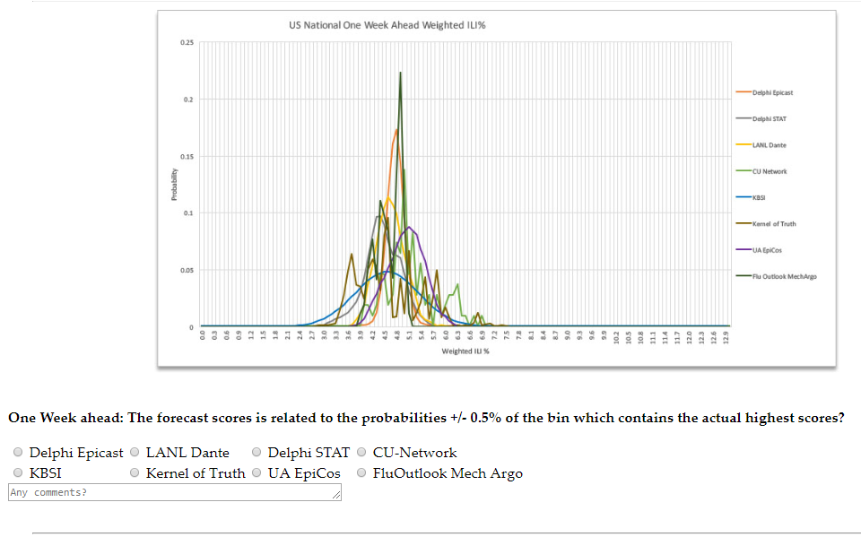
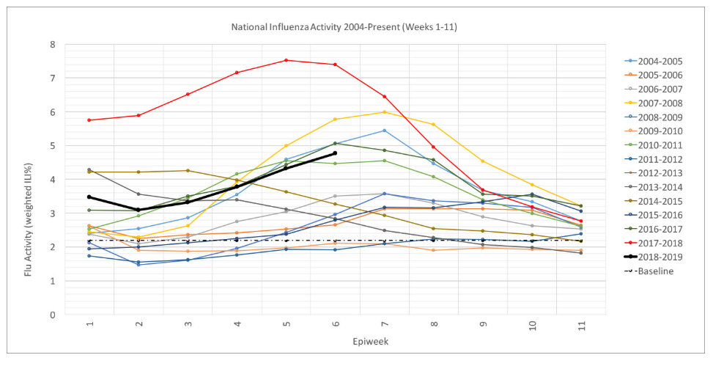
Website
http://www.influenzamodelselection.com/

Slide 19
Incentives for Participation
Open to suggestions
Cash Prizes and Random Drawings
Potential for Extra Credit
Acknowledgements in subsequent papers and presentations
Potential for co-authorship

Slide 20
Acknowlegements
Inspiration and Guidance: Matt Biggerstaff, Jean-Paul Chretien, F. Scott Dahlgren, Suchada Foster, Robert Huffman, Michael Johansson, Paul Lewis, Craig McGowan, Nicholas Reich, Roni Rosenfeld, and Otto Wilson
Participants: Elena Berger, Emily Briskin, Jessica Fung Deerin, Suchada Foster, Scott Gilje, Mary-Ashley Hazel, Bryan Lewis, Paul Lewis, Karen Martin, Jeff Morgan, Steve Morgan, Jonathan Phillips, Kaiyuan Sun, Srinivasan Venkatramanan and Cecile Viboud

